Slide 1




Phoenix Student
Management System (SMS)

Slide 2
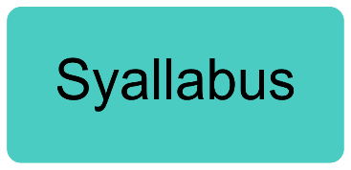
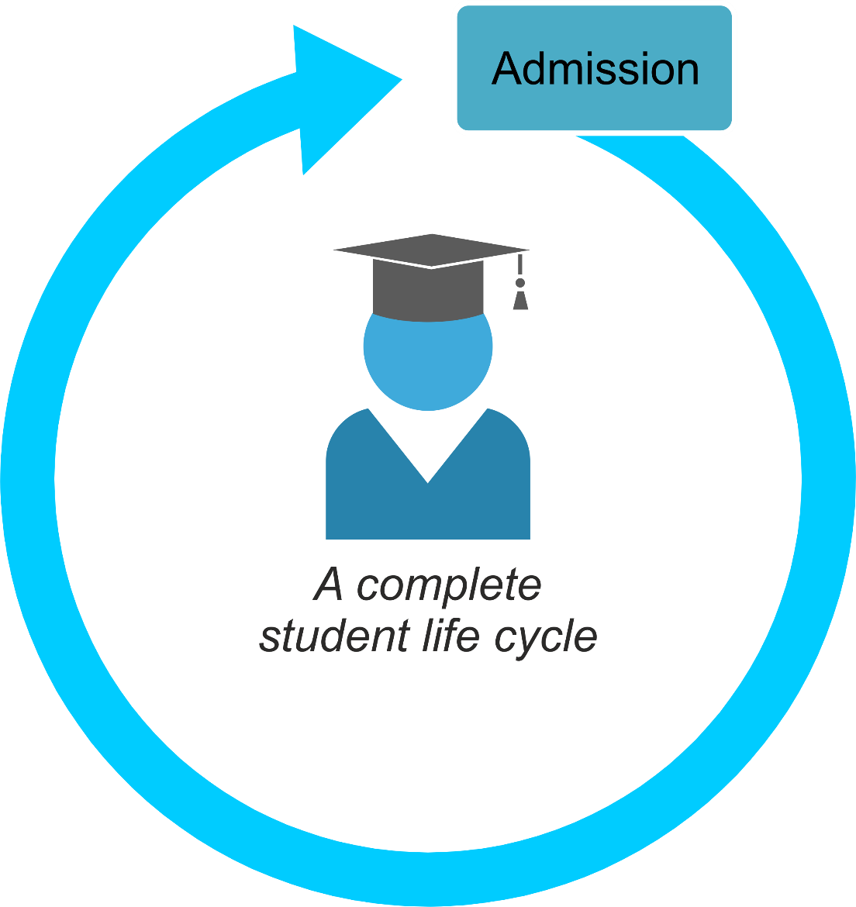
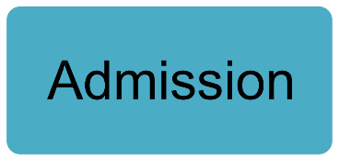
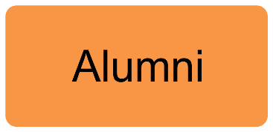
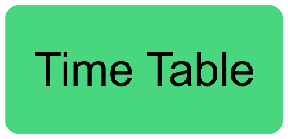
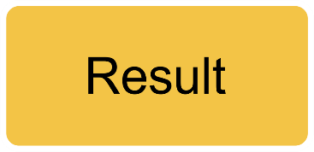
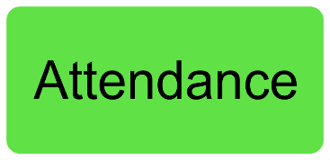
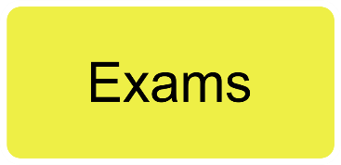
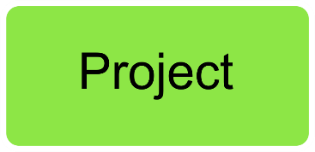
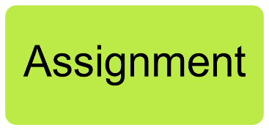
Student Life Cycle

Slide 3


Student Life Cycle
A complete
student life cycle

Slide 4




Transport Facility
Bye son,
take care
Phoenix SMS
Your Child has boarded school bus.
Bye Mom

Slide 5


Transport Facility
Phoenix SMS
Your Child has left school buy & reached school

Slide 6






Attendance Process
Classroom
Phoenix SMS
Your Child is marked Present today

Slide 7


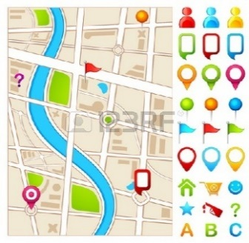



GPS Tracking

Slide 8




Library Management
Phoenix SMS - Library
Issued Book Name: ABC
Issue Date: DD MM YY
Due Data: DD MM YY
Phoenix SMS - Library
Due date today, please return issued book ABC today to avoid late charges, post due date late charges Rs.10 per day.

Slide 9




Assignment / Project
Phoenix SMS
Assignment / Project assigned, for more details login to Phoenix SMS Portal.
Assignment
Submit
Submit

Slide 10
Class Time Table / Exam Time Table
Phoenix SMS
Class Time Table / Exam Time Table assigned, for more details login to Phoenix SMS Portal
Time Table
Submit
Submit

Slide 11
Marks & Results
Phoenix SMS
Result generated, for more details login to Phoenix SMS portal.
Exam Result
Subject
Marks
Generate Result
Generate Result

Slide 12
Marks & Results
Phoenix SMS
Your child promoted to next class, for more details login to Phoenix SMS portal.
Promote to next Class
Student
Promote

Slide 13




Cloud based Data Security

Slide 14










Alumni

Slide 15



Contact us
Get in touch
www.alacritytechnologies.com
amit@alacritytechnologies.com
+91 9322696256

